Slide 1
November 5 Update

Slide 2
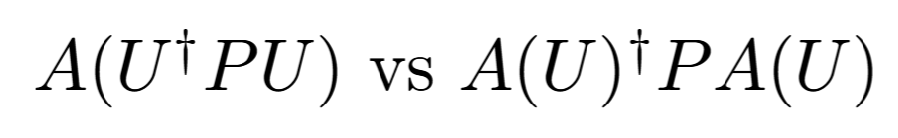

Slide 3
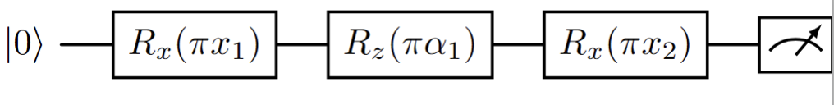
Calculation

Slide 4
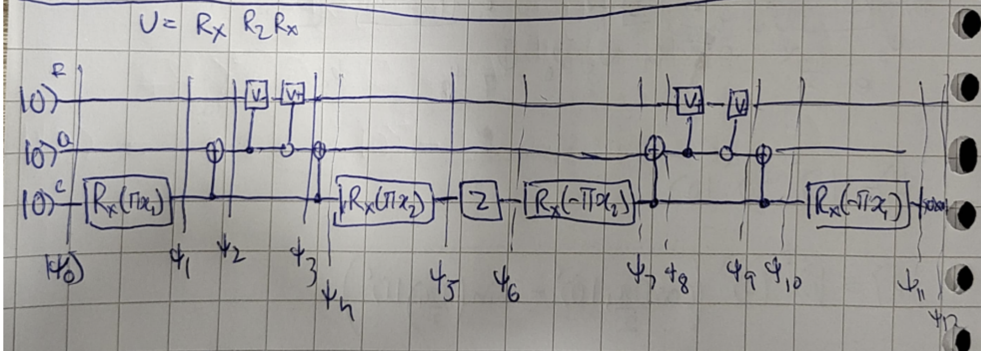
Calculation

Slide 5
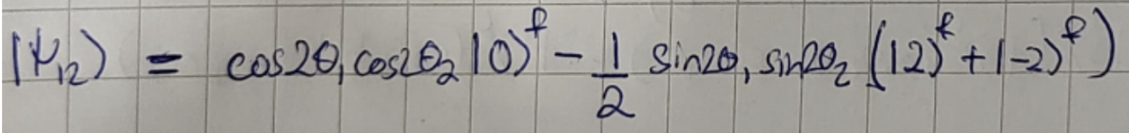
Calculation

Slide 6
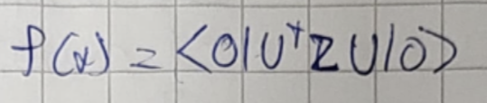
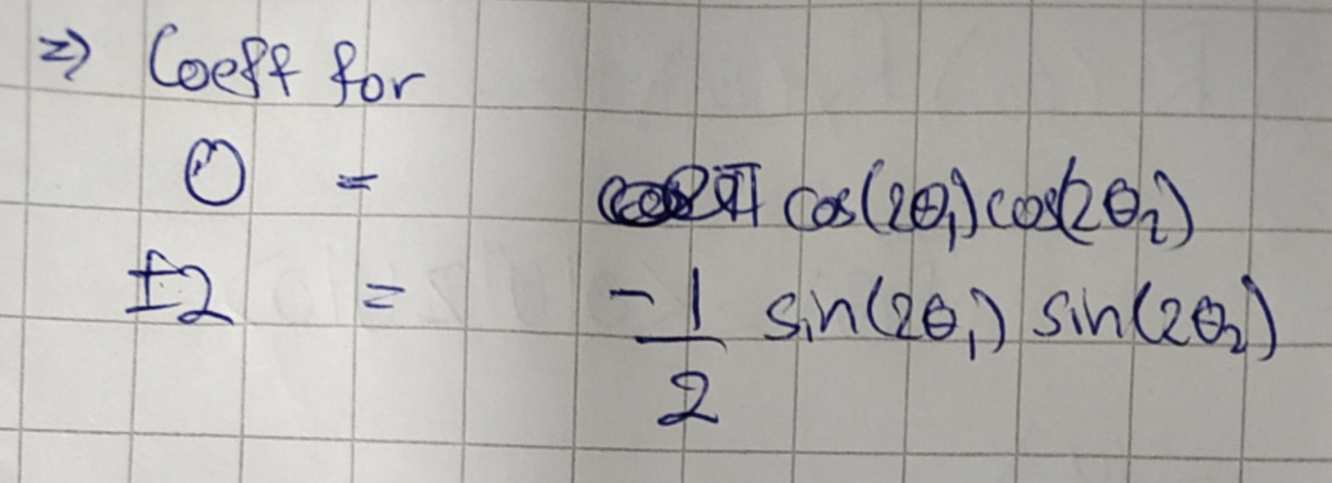
Calculation

Slide 7
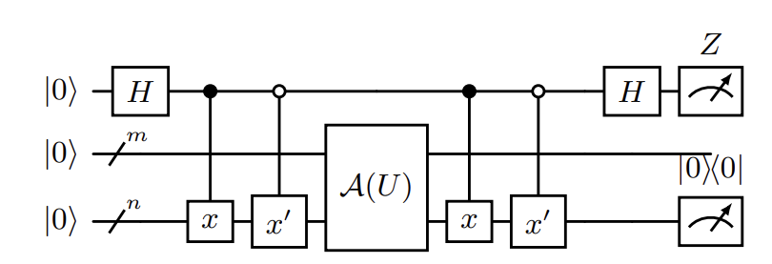

Slide 8
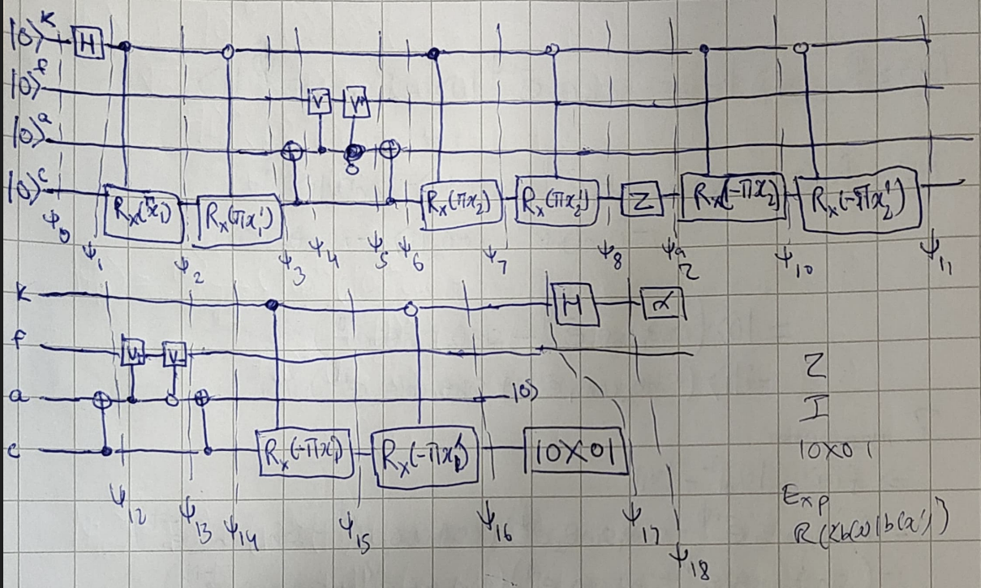

Slide 9
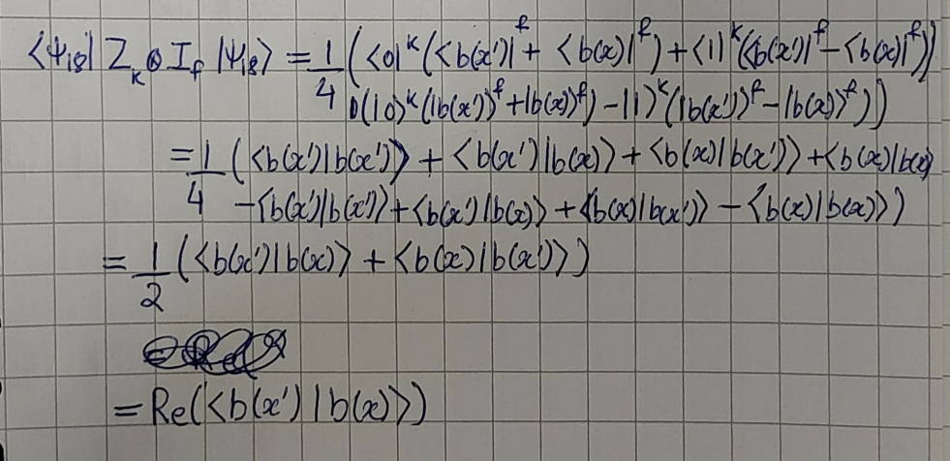

Slide 10
Possible Generalization?
Count all possible combinations of frequencies, and change V₊ and V₋ depending on encoding gate
With R_{z}, H, CNOT we can represent any gate so can convert it into those gates with R_{z} being encoding and H, CNOT being fixed gates.

Slide 11
High Dimensional Probability Book
Convex Combination and Convex Hull
Caratheodory and Approximate Caratheodory Theorem
Covering polytopes by balls

Slide 12
Code?

Slide 13
MyCase

Slide 14
Things to do
Read books
Reorganize notes
Code
MyCase
PhD
Give more detail for generalization idea and send it

